Slide 1

Decision Trees, Sorting Lower-Bound

Slide 2
Comparison-based sorting algorithms
Rearrange elements by element-wise comparisons
Insertion Sort: A[j] > A[i]?
Quicksort: A[j] ≤ A[r]?
Within partition, Key has the same value as A[r]
Mergesort: A[i] ≤ A[j]?
Within merge
■
All of them are comparison-based sorting
■
Non-comparison-based sorting: radix sort

Slide 3
Decision Tree
A decision tree is a binary tree that represents the comparisons between elements that are performed by a particular sorting algorithm, operating on an input of a given size.
We
annotate each internal node by the
comparison
made at the corresponding step
of the algorithm.
We
annotate each leaf node by a
permutation
<π(1), π(2), …, π(n)>.

Slide 4
Decision Tree
A decision tree corresponds to a sorting algorithm for a given length of the input sequence.
Therefore, we have
a decision tree for insertion
sort on 3 elements
. We have
a decision tree for
quicksort on 10 elements
, etc.
We do not have a decision tree for insertion sort.
We do not have a decision tree for quicksort on the input sequence 3, 5, 8.

Slide 5
Decision Tree
Each path from the root node to a leaf node represents the execution of the algorithm on a particular input.
Since there are 𝒏𝒏! possible results for sorting an 𝒏𝒏-elements array A[1], A[2], …, A[n], there are 𝒏𝒏! leaf nodes in a decision tree for a sorting algorithm on n elements.

Slide 6
Insertion Sort
Insertion-Sort(A, n)
for i := 2 to n do
key := A[i]
// insert A[i] into sorted A[1..i-1]
j := i -1
while j > 0 and A[j] > key do
6
7
8 A[j+1] := key
A[j+1] := A[j]
j := j - 1
Trace the algorithm using inputs: 3 5 2 8 3

Slide 7
DT for Insertion Sort on <a₁, a₂, a₃>
a₁>a₂?
N
Y
a₂>a₃?
a₁>a₃?
N
Y
N
Y
<a₁,a₂,a₃>
a₁>a₃?
<a₂,a₁,a₃>
a₂>a₃?
N
Y
N
Y
<a₁,a₃,a₂>
<a₃,a₁,a₂>
<a₂,a₃,a₁>
<a₃,a₂,a₁>
Array content is
a₁
a₂ a₃
. Insert a₂.

Slide 8
DT for Insertion Sort on <a₁, a₂, a₃>
a₁>a₂?
N
Y
a₂>a₃?
a₁>a₃?
N
Y
N
Y
<a₁,a₂,a₃>
a₁>a₃?
<a₂,a₁,a₃>
a₂>a₃?
N
Y
N
Y
<a₁,a₃,a₂>
<a₃,a₁,a₂>
<a₂,a₃,a₁>
<a₃,a₂,a₁>
Array content is
Is a₁>a₂?
a₁
a₂ a₃
. Insert a₂.

Slide 9

DT for Insertion Sort on <a₁, a₂, a₃>
a₁>a₂?
N
Y
a₂>a₃?
a₁>a₃?
N
Y
N
Y
<a₁,a₂,a₃>
a₁>a₃?
<a₂,a₁,a₃>
a₂>a₃?
N
Y
N
Y
<a₁,a₃,a₂>
<a₃,a₁,a₂>
<a₂,a₃,a₁>
<a₃,a₂,a₁>
Array content is
Is a₁>a₂? No
Array content is
a₁
a₂ a₃
. Insert a₂.
a₁ a₂
a₃
. Insert a₃.

Slide 10


DT for Insertion Sort on <a₁, a₂, a₃>
a₁>a₂?
N
Y
a₂>a₃?
a₁>a₃?
N
Y
N
Y
<a₁,a₂,a₃>
a₁>a₃?
<a₂,a₁,a₃>
a₂>a₃?
N
Y
N
Y
<a₁,a₃,a₂>
<a₃,a₁,a₂>
<a₂,a₃,a₁>
<a₃,a₂,a₁>
Array content is
Is a₁>a₂? No
Array content is
Is a₂>a₃? No
a₁
a₂ a₃
. Insert a₂.
a₁ a₂
a₃
. Insert a₃.

Slide 11

DT for Insertion Sort on <a₁, a₂, a₃>
a₁>a₂?
N
Y
a₂>a₃?
a₁>a₃?
N
Y
N
Y
<a₁,a₂,a₃>
a₁>a₃?
<a₂,a₁,a₃>
a₂>a₃?
N
Y
N
Y
<a₁,a₃,a₂>
<a₃,a₁,a₂>
<a₂,a₃,a₁>
<a₃,a₂,a₁>
Array content is
Is a₁>a₂? No
Array content is
Is a₂>a₃? No
a₁
a₂ a₃
. Insert a₂.
a₁ a₂
a₃
. Insert a₃.
STOP with a₁ a₂ a₃.

Slide 12

DT for Insertion Sort on <a₁, a₂, a₃>
a₁>a₂?
N
Y
a₂>a₃?
a₁>a₃?
N
Y
N
Y
<a₁,a₂,a₃>
a₁>a₃?
<a₂,a₁,a₃>
a₂>a₃?
N
Y
N
Y
<a₁,a₃,a₂> <a₃,a₁,a₂> <a₂,a₃,a₁>
<a₃,a₂,a₁>
Array content is
Array content is
a₁
a₂ a₃
. Insert
. Insert
a₂
. Is a₁>a₂? No
. Is a₂>a₃? Yes
a₁ a₂
a₃
a₃

Slide 13
DT for Insertion Sort on <a₁, a₂, a₃>
a₁>a₂?
N
Y
a₂>a₃?
a₁>a₃?
N
Y
N
Y
<a₁,a₂,a₃>
a₁>a₃?
<a₂,a₁,a₃>
a₂>a₃?
N
Y
N
Y
<a₁,a₃,a₂> <a₃,a₁,a₂> <a₂,a₃,a₁>
<a₃,a₂,a₁>
Array content is
Array content is
Array content is
a₁ | a₂ a₃
a₁ a₂ |  |  |  | a₃
a₁ |  | a₂ | a₂
. Insert
. Insert
a₂
. Is a₁>a₂? No
. Is a₂>a₃? Yes
a₃
. Is a₁>a₃?

Slide 14

DT for Insertion Sort on <a₁, a₂, a₃>
a₁>a₂?
N
Y
a₂>a₃?
a₁>a₃?
N
Y
N
Y
<a₁,a₂,a₃>
a₁>a₃?
<a₂,a₁,a₃>
a₂>a₃?
N
Y
N
Y
<a₁,a₃,a₂> <a₃,a₁,a₂> <a₂,a₃,a₁>
<a₃,a₂,a₁>
Array content is
Array content is
Array content is
a₁ | a₂ a₃
a₁ a₂ |  |  |  | a₃
a₁ |  | a₂ | a₂
. Insert
. Insert
a₂
. Is a₁>a₂? No
. Is a₂>a₃? Yes
a₃
. Is a₁>a₃? No

Slide 15
DT for Insertion Sort on <a₁, a₂, a₃>
a₁>a₂?
N
Y
a₂>a₃?
a₁>a₃?
N
Y
N
Y
<a₁,a₂,a₃>
a₁>a₃?
<a₂,a₁,a₃>
a₂>a₃?
N
Y
N
Y
<a₁,a₃,a₂> <a₃,a₁,a₂> <a₂,a₃,a₁>
<a₃,a₂,a₁>
Array content is
a₁
a₂ a₃
. Insert
. Insert
a₂
. Is a₁>a₂? No
. Is a₂>a₃? Yes
Array content is
a₁ a₂
a₃
a₃
Array content is
a₁
a₂
a₂
. Is a₁>a₃? No
STOP with
a₁ a₃ a₂
.

Slide 16

DT for Insertion Sort on <a₁, a₂, a₃>
a₁>a₂?
N
Y
a₂>a₃?
a₁>a₃?
N
Y
N
Y
<a₁,a₂,a₃>
a₁>a₃?
<a₂,a₁,a₃>
a₂>a₃?
N
Y
N
Y
<a₁,a₃,a₂> <a₃,a₁,a₂> <a₂,a₃,a₁>
<a₃,a₂,a₁>
Array content is
Array content is
Array content is
Array content is
a₁ | a₂ a₃
a₁ a₂ |  |  |  | a₃
a₁ |  | a₂ | a₂
a₁ | a₁ a₂
. Insert
. Insert
a₂
. Is a₁>a₂? No
. Is a₂>a₃? Yes
a₃
. Is a₁>a₃? Yes
.

Slide 17
DT for Insertion Sort on <a₁, a₂, a₃>
a₁>a₂?
N
Y
a₂>a₃?
a₁>a₃?
N
Y
N
Y
<a₁,a₂,a₃>
a₁>a₃?
<a₂,a₁,a₃>
a₂>a₃?
N
Y
N
Y
<a₁,a₃,a₂> <a₃,a₁,a₂> <a₂,a₃,a₁>
<a₃,a₂,a₁>
Array content is
a₁
a₂ a₃
. Insert
. Insert
a₂
. Is a₁>a₂? No
. Is a₂>a₃? Yes
Array content is
a₁ a₂
a₃
a₃
Array content is
a₁
a₂
a₂
. Is a₁>a₃? Yes
. Overwrite A[1] with a₃.
Array content is
a₁
a₁ a₂
STOP with
a₃ a₁ a₂
.

Slide 18
DT for Insertion Sort on <a₁, a₂, a₃>
a₁>a₂?
N
Y
a₂>a₃?
a₁>a₃?
N
Y
N
Y
<a₁,a₂,a₃>
a₁>a₃?
<a₂,a₁,a₃>
a₂>a₃?
N
Y
N
Y
<a₁,a₃,a₂>
<a₃,a₁,a₂>
<a₂,a₃,a₁>
<a₃,a₂,a₁>
Continue this process, we can draw the complete decision tree for Insertion sort on three elements.

Slide 19
DT for Insertion Sort on <a₁, a₂, a₃>
There are 3!=6 leaf nodes in the decision tree for Insertion Sort on three elements.
Each root-to-leaf path corresponds to the execution of the algorithm for the corresponding input.
Example: If the input is 18, 10, 15, the sorted order is
𝒂𝒂_{𝟐𝟐}, 𝒂𝒂_{𝟑𝟑}, 𝒂𝒂_{𝟏𝟏}. Therefore, the execution of the algorithm corresponds to the path from the root node to the leaf node <𝒂𝒂_{𝟐𝟐}, 𝒂𝒂_{𝟑𝟑}, 𝒂𝒂_{𝟏𝟏}>.

Slide 21


DT for Insertion Sort on <a₁, a₂, a₃, a₄>
a₁>a₂?
N
Y
a₂>a₃?
a₁>a₃?
N
Y
N
Y
<a₁,a₂,a₃>
a₁>a₃?
<a₂,a₁,a₃>
a₂>a₃?
N
Y
N
Y
<a₁,a₃,a₂>
<a₃,a₁,a₂>
<a₂,a₃,a₁>
<a₃,a₂,a₁>
For Insertion sort, we can grow the DT for 3 elements to the DT for 4 elements.
The internal nodes will stay. The leaf nodes need to be changed.
■
This growing process does not work for Mergesort or Quicksort.

Slide 22
DT for Insertion Sort on <a₁, a₂, a₃, a₄>
a₁>a₂?
N
Y
a₂>a₃?
a₁>a₃?
Y
Y
a₁>a₃?
a₂>a₃?

Slide 23


DT for Insertion Sort on <a₁, a₂, a₃, a₄>
a₁>a₂?
N
Y
a₂>a₃?
a₁>a₃?
N
Y
N
Y
a₃>a₄?
a₁>a₃?
a₂>a₃?
N
N
Y
N
Y
<a₁,a₂,a₃,a₄>
Array content is
a₁
a₂ a₃ a₄
. Insert
. Insert
. Insert
a₂
. Is a₁>a₂? No
. Is a₂>a₃? No
. Is a₃>a₄? No
Array content is
a₁ a₂
a₃ a₄
a₃
Array content is
a₁ a₂ a₃
a₄
a₄
STOP with
a₁ a₂ a₃ a₄
.

Slide 24

DT for Insertion Sort on <a₁, a₂, a₃, a₄>
a₁>a₂?
N
Y
a₂>a₃?
a₁>a₃?
N
Y
Y
a₃>a₄?
a₁>a₃?
a₂>a₃?
N
Y
<a₁,a₂,a₃,a₄>
a₂>a₄?
Array content is
Array content is
Array content is
Array content is
a₁ | a₂ a₃ a₄
a₁ a₂ |  | a₃ a₄
a₁ a₂ a₃ |  |  |  | a₄
a₁ a₂ |  | a₃ | a₃
. Insert
. Insert
. Insert
.
a₂
. Is a₁>a₂? No
. Is a₂>a₃? No
. Is a₃>a₄? Yes Is a₂>a₄?
a₃
a₄
The process would continue until we have the complete DT for Insertion sort on 4 elements

Slide 25
DT for Insertion Sort on <a₁, a₂, a₃, a₄>
a₁>a₂?
N
Y
a₂>a₃?
a₁>a₃?
N
Y
Y
a₃>a₄?
a₁>a₃?
a₂>a₃?
N
Y
<a₁,a₂,a₃,a₄>
a₂>a₄?

Slide 26
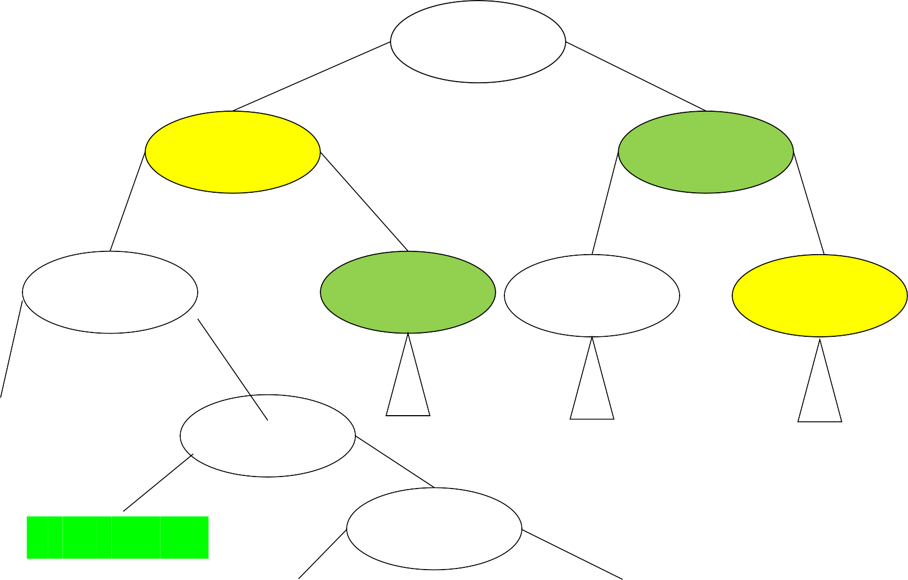
There are n!-1 internal nodes
a₁>a₂?
N
Y
a₂>a₃?
a₁>a₃?
N
Y
N
Y
a₃>a₄?
a₁>a₃?
a₃>a₄?
a₂>a₃?
N
Y
<a₁,a₂,a₃ ,a₄> _{N}
a₂>a₄?
Y
<a₁,a₂,a₄,a₃>
a₁>a₄?
N
Y
<a₁,a₄,a₂,a₃>
<a₄,a₁,a₂,a₃>

Slide 27
There are n!-1 internal nodes
a₁>a₂?
N
Y
a₂>a₃?
a₁>a₃?
N
Y
N
Y
<a₁,a₂,a₃>
a₁>a₃?
<a₂,a₁,a₃>
a₂>a₃?
N
Y
N
Y
<a₁,a₃,a₂> <a₃,a₁,a₂> <a₂,a₃,a₁>
There are 𝒏𝒏! internal nodes.
There are 𝑶𝑶(𝒏𝒏^{𝟐𝟐}) possible comparisons.
The same comparison may appear in multiple internal nodes.
<a₃,a₂,a₁>

Slide 28
DT for Insertion Sort on <a₁, a₂, a₃, a₄>
There are 4!=24 leaf nodes in the decision tree for Insertion Sort on four elements.
Each root-to-leaf path corresponds to the execution of the algorithm for the corresponding input.
Example: If the input is <2, 4, 6, 1>, the sorted order is
𝒂𝒂_{𝟒𝟒}, 𝒂𝒂_{𝟏𝟏}, 𝒂𝒂_{𝟐𝟐}, 𝒂𝒂_{𝟑𝟑}. Therefore, the execution of the algorithm corresponds to the path from the root node to the leaf node <𝒂𝒂_{𝟒𝟒}, 𝒂𝒂_{𝟏𝟏}, 𝒂𝒂_{𝟐𝟐}, 𝒂𝒂_{𝟑𝟑}>.

Slide 30
The Quicksort Algorithm
QuickSort(A, p, r)
1 if p < r
q = Partition(A, p, r)
QuickSort(A, p, q-1)
QuickSort(A, q+1, r)
Partition(A, p, r)
1 x := A[r]
2 i := p-1
for j:=p to r-1 do
If A[j] ≤ x then
5 i := i+1
6
7
8
9
10
11
temp = A[i]
A[i] = A[j]
A[j] = temp
temp = A[i+1]
A[i+1] = A[r]
A[r] = temp
12 return i+1

Slide 31

DT for Quicksort on <a₁, a₂, a₃>
a₁≤a₃?
N
Y
a₂≤a₃?
a₂≤a₃?
N
Y
N
Y
a₂≤a₁?
<a₂,a₃,a₁> <a₁,a₃,a₂>
N
Y
a₁≤a₂?
N
Y
a₃,a₁,a₂> <a₃,a₂,a₁>
<a₂,a₁,a₃> <a₁,a₂,a₃>

Slide 32

DT for Quicksort on <a₁, a₂, a₃>
a₁≤a₃?
N
Y
a₂≤a₃?
a₂≤a₃?
N
Y
N
Y
a₂≤a₁?
<a₂,a₃,a₁> <a₁,a₃,a₂>
N
Y
a₁≤a₂?
N
Y
a₃,a₁,a₂> <a₃,a₂,a₁>
<a₂,a₁,a₃> <a₁,a₂,a₃>

Slide 33

DT for Quicksort on <a₁, a₂, a₃>
a₁≤a₃?
N
Y
a₂≤a₃?
a₂≤a₃?
N
Y
N
Y
a₂≤a₁?
<a₂,a₃,a₁> <a₁,a₃,a₂>
N
Y
a₁≤a₂?
N
Y
a₃,a₁,a₂> <a₃,a₂,a₁>
<a₂,a₁,a₃> <a₁,a₂,a₃>

Slide 34

DT for Quicksort on <a₁, a₂, a₃>
a₁≤a₃?
N
Y
a₂≤a₃?
a₂≤a₃?
N
Y
N
Y
a₂≤a₁?
<a₂,a₃,a₁> <a₁,a₃,a₂>
N
Y
a₁≤a₂?
N
Y
a₃,a₁,a₂> <a₃,a₂,a₁>
<a₂,a₁,a₃> <a₁,a₂,a₃>

Slide 35
DT for Quicksort on <a₁, a₂, a₃>
a₁≤a₃?
N
Y
a₂≤a₃?
a₂≤a₃?
N
Y
N
Y
a₂≤a₁?
<a₂,a₃,a₁> <a₁,a₃,a₂>
N
Y
a₁≤a₂?
N
Y
a₃,a₁,a₂> <a₃,a₂,a₁>
<a₂,a₁,a₃> <a₁,a₂,a₃>

Slide 36

DT for Quicksort on <a₁, a₂, a₃>
a₁≤a₃?
N
Y
a₂≤a₃?
a₂≤a₃?
N
Y
N
Y
a₂≤a₁?
<a₂,a₃,a₁> <a₁,a₃,a₂>
N
Y
a₁≤a₂?
N
Y
a₃,a₁,a₂> <a₃,a₂,a₁>
<a₂,a₁,a₃> <a₁,a₂,a₃>

Slide 37

DT for Quicksort on <a₁, a₂, a₃>
a₁≤a₃?
N
Y
a₂≤a₃?
a₂≤a₃?
N
Y
N
Y
a₂≤a₁?
<a₂,a₃,a₁> <a₁,a₃,a₂>
N
Y
a₁≤a₂?
N
Y
a₃,a₁,a₂>
<
a₃,a₂,a₁>
<a₂,a₁,a₃> <a₁,a₂,a₃>

Slide 38
Merge Algorithm
Merge(A, p, q, r)
// A[p:q]and A[q+1:r] are already sorted
01: nL = q – p + 1; 02: nR = r – q;
03: new L[0:nL-1]; new R[0:nR-1];
04: for i=0 to nL-1
// nL is the length of A[p:q]
// nR is the length of A[q+1:r]
// two new arrays
//
// L[0:nL-1] = A[p:q]
//
// R[0:nR-1] = A[q+1:r]
// i points to the start of L[]
// j points to the start of R[]
// k points to the start of A[]
05: L[i] = A[p+i];
06: for j=0 to nR-1
07: R[j] = A[q+j+1];
08: i = 0;
09: j = 0;
10: k = p;
12: while i < nL and j < nR 13: if L[i] <= R[j];
//
//
14: A[k] = L[i];
15: i = i+1;
// L[i] is k-th smallest
//
16: else A[k] = R[j]; 17: j = j+1;
// R[j] is k-th smallest
//
18: k = k+1;
20: while i < nL 21: A[k] = L[i];
22: i = i+1;
23: k = k+1;
24: while j < nR 25: A[k] = R[j];
26: j = j+1;
27: k = k+1;
//
// 20-23 and 24-27 are mutually exclusive
// copy rest of L[] to A[]
//
//
//
// copy rest of R[] to A[]
//
//

Slide 39
DT for Mergesort on <a₁, a₂, a₃>
a₁≤a₂?
N
Y
a₂≤a₃?
a₁≤a₃?
N
Y
N
Y
<a₃,a₂,a₁>
a₁≤a₃?
<a₃,a₁,a₂>
a₂≤a₃?
N Y
<a₂,a₃,a₁> <a₂,a₁,a₃>
N Y
<a₁,a₃,a₂> <a₁,a₂,a₃>

Slide 40
DT for Mergesort on <a₁, a₂, a₃>
a₁≤a₂?
N
Y
a₂≤a₃?
a₁≤a₃?
N
Y
N
Y
<a₃,a₂,a₁>
a₁≤a₃?
<a₃,a₁,a₂>
a₂≤a₃?
N Y
<a₂,a₃,a₁> <a₂,a₁,a₃>
N Y
<a₁,a₃,a₂> <a₁,a₂,a₃>

Slide 41
DT for Mergesort on <a₁, a₂, a₃>
a₁≤a₂?
N
Y
a₂≤a₃?
a₁≤a₃?
N
Y
N
Y
<a₃,a₂,a₁>
a₁≤a₃?
<a₃,a₁,a₂>
a₂≤a₃?
N Y
<a₂,a₃,a₁> <a₂,a₁,a₃>
N Y
<a₁,a₃,a₂> <a₁,a₂,a₃>

Slide 42

DT for Mergesort on <a₁, a₂, a₃>
a₁≤a₂?
N
Y
a₂≤a₃?
a₁≤a₃?
N
Y
N
Y
<a₃,a₂,a₁>
a₁≤a₃?
<a₃,a₁,a₂>
a₂≤a₃?
N Y
<a₂,a₃,a₁> <a₂,a₁,a₃>
N Y
<a₁,a₃,a₂> <a₁,a₂,a₃>

Slide 43
DT for Mergesort on <a₁, a₂, a₃>
a₁≤a₂?
N
Y
a₂≤a₃?
a₁≤a₃?
N
Y
N
Y
<a₃,a₂,a₁>
a₁≤a₃?
<a₃,a₁,a₂>
a₂≤a₃?
N Y
<a₂,a₃,a₁> <a₂,a₁,a₃>
N Y
<a₁,a₃,a₂> <a₁,a₂,a₃>

Slide 45
Sorting lower-bound
The length of the longest path from the root to a leaf in the decision tree represents the worst-case number of comparisons the sorting algorithm performs.
Worst-case number of comparisons corresponds to height of the decision tree of the algorithm.

Slide 46
Height of a Binary Tree
Minimum height of a binary tree→A binary tree of height k has at most 2^{k+1}-1 nodes.
At most 2^{k-1} nodes at level k-1
At most 2^{k+1}-1 nodes total.
As a result,
the minimum height of a binary tree with
N nodes is floor(log(N)).
In a decision tree for using a comparison-based sorting algorithm to sort n elements, there are n! leaf nodes. Hence the height is Ω(log(n!)).

Slide 47
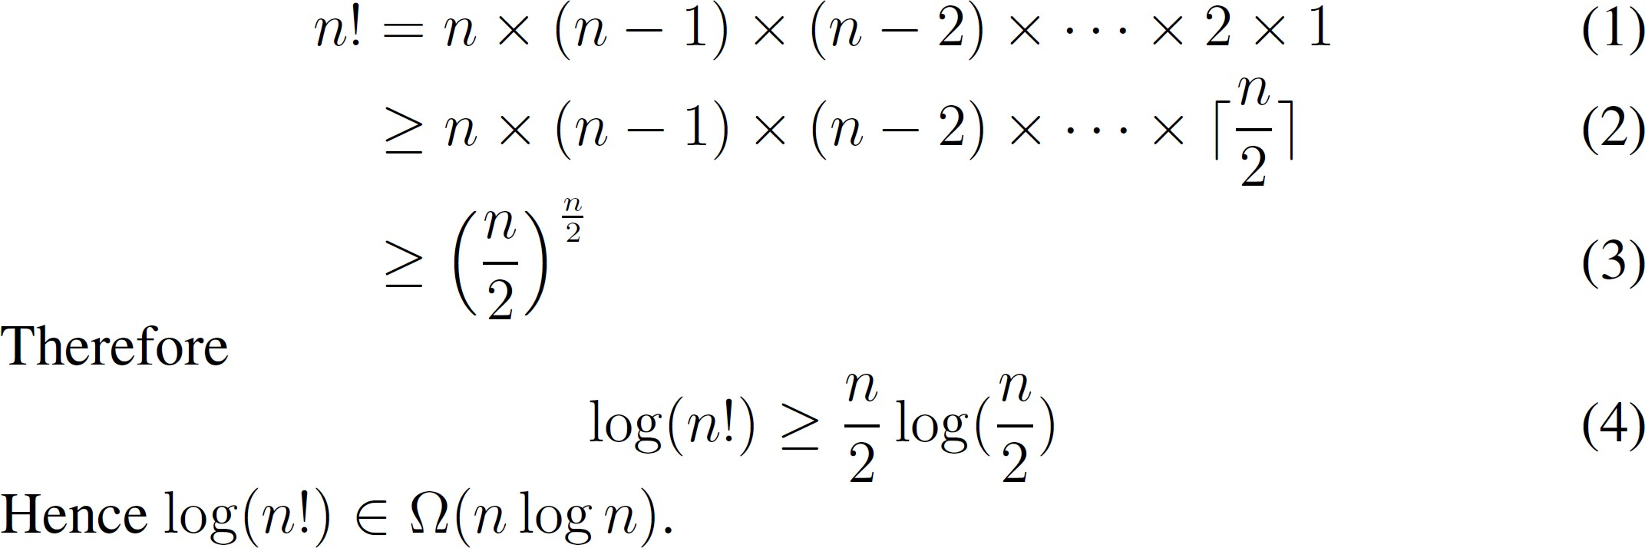
Sorting lower-bound

Slide 48
Sorting lower-bound

Slide 49
Summary
The DT for a comparison-based sorting algorithm on n elements has n! leaf nodes.
The height of a decision tree corresponds to the worst-case time complexity of the corresponding sorting algorithm, when sorting the given number of elements.
The height of the DT is lower bounded by Ω(log(n!)), which is Ω(n*log(n)).
Comparison based sorting has Ω(n*log(n)) as an asymptotic lower bound.

